Slide 1
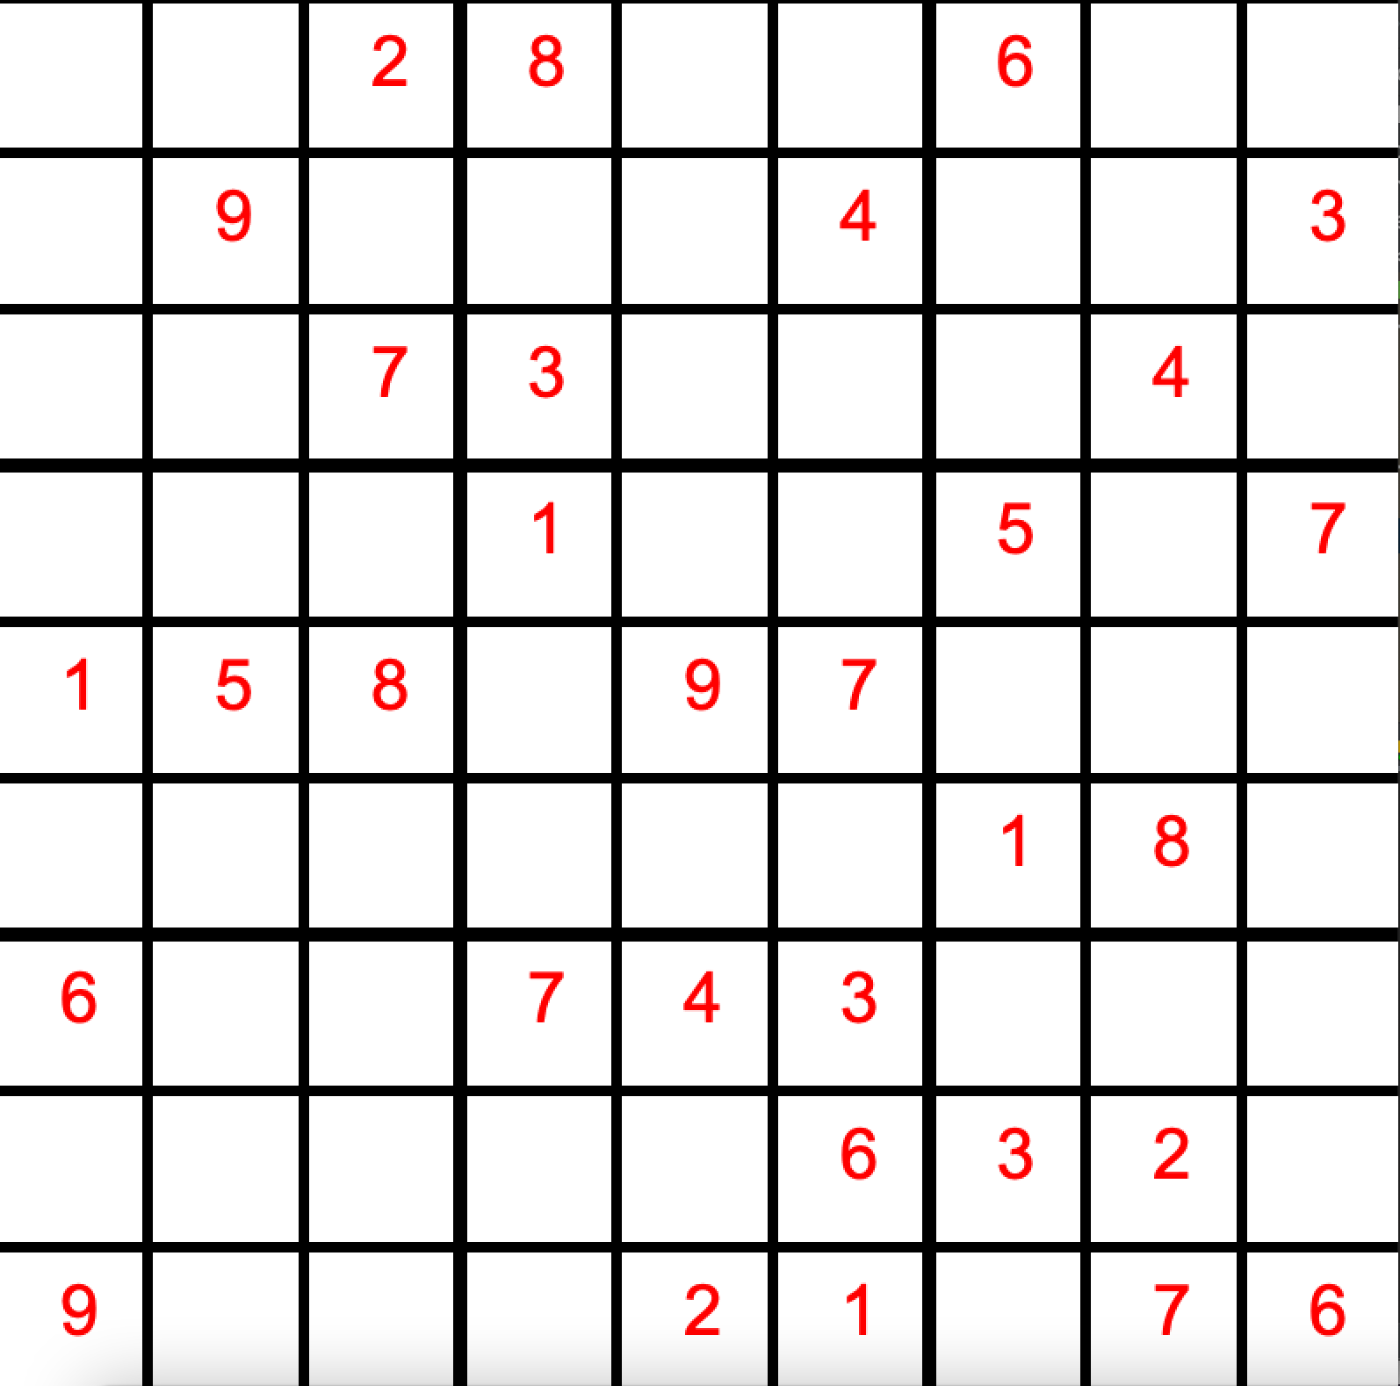
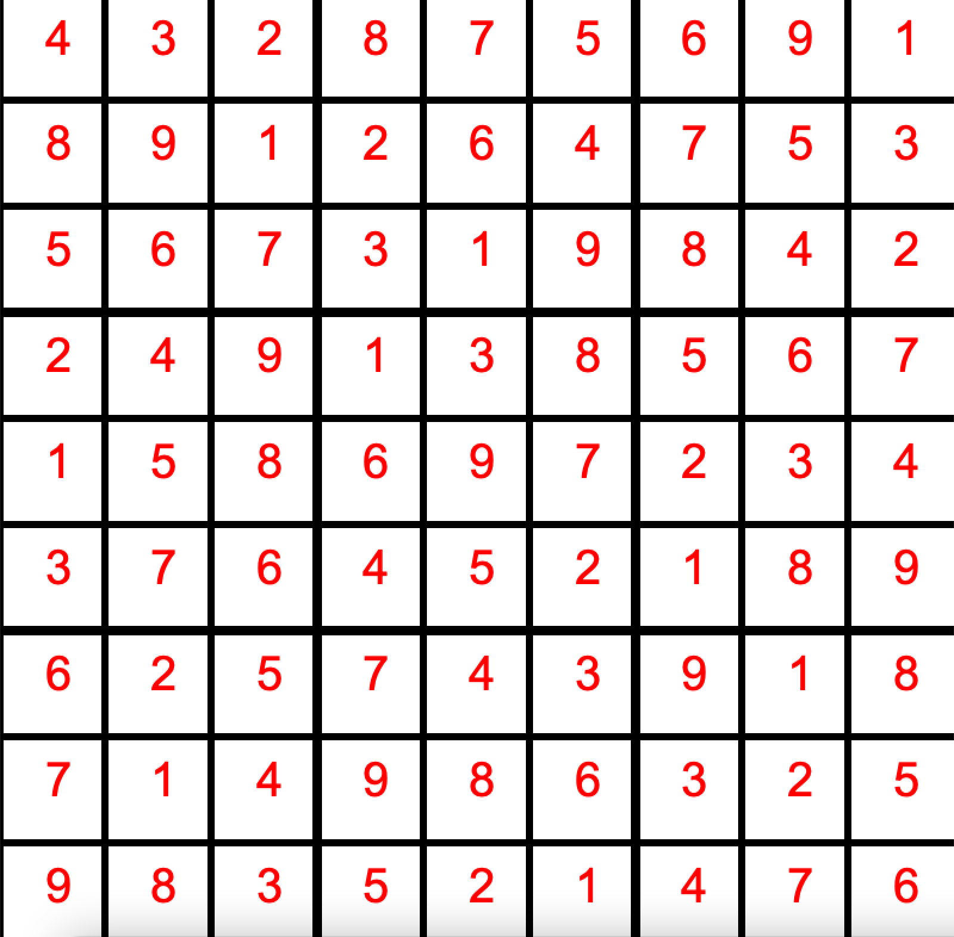
Sudoku Project
DataNiners: Lucy, Ashley, Ryan, Matthew

Slide 2
Algorithm Design
Recursive Backtracking:
Leveraged by sudoku_solve() and sudoku_create()
Find an empty location
If no empty locations, puzzle is solved
Iterate through a list of numbers
If number is a valid input, set the empty location to the number
Continue until no empty locations or no answers are possible in a slot
If no answers possible, set slot to 0 and recurse back and try the next number in list
3 different methods utilize recursive backtracking
Solver (solves puzzle), solver_backward (checks for multiple solutions), solver_random (creates new random puzzle)

Slide 3
Code Organization
Board Data Structure:
A board is a struct that holds a 2D array of integers
Board.h holds functions for creating a board, getting and setting numbers within the board, checking numbers to see if they are valid inputs, checking the board for empty slots, freeing a boards memory, copying a board
Helps reduce clutter in sudoku.c
Sudoku.c
sudoku_solve() calls relevant functions to store a puzzle inputted from stdin in a board, use recursive backtracking to solve the puzzle, and then print the puzzle to stdout
sudoku_create() calls relevant functions to create a blank puzzle, call recursive backtracking on the puzzle using random lists to make new puzzles every time, removes a certain number of slots from the board while ensuring there is only one solution, and prints the puzzle to stdout

Slide 4
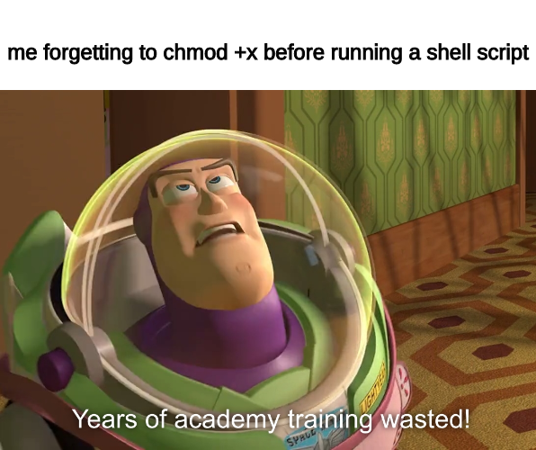

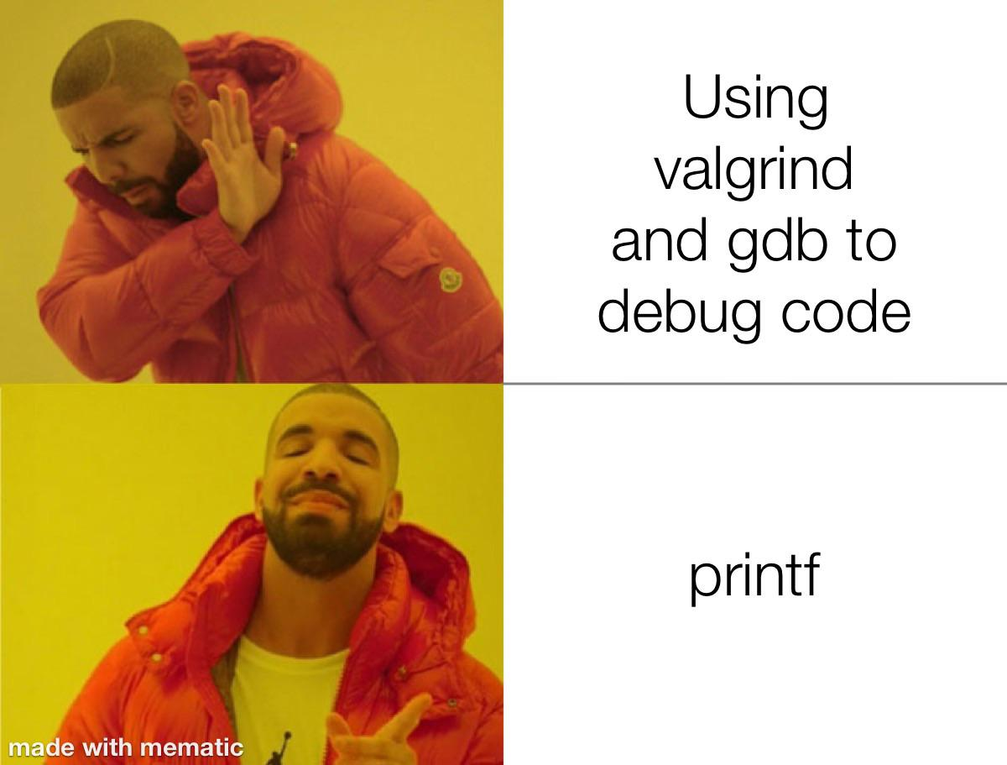
Testing Strategy
Integration testing and Fuzz testing
testing.sh and valgrind.sh
Edge cases for ‘solve’ and ‘create’
fuzz.c and fuzz.sh
Validate sudoku board by checking sums and duplicates (fuzz.c)
Solver checks for unique solution
Compares created with solved board to check if solver changed any slots given by the creator (fuzz.c)

Slide 5

Lessons Learned
Collaboration
Github specifics
Play to your strengths
Problem solving
Creativity
Open mindedness

Slide 6
Work Partition
Lucy:
Worked on board data structure, helped debug sudoku.c, implemented graphics in Python, addressed memory leaks
Ashley:
Worked on sudoku.c (specifically the solver), wrote the README.md, DESIGN.md, and Makefile
Matthew:
Worked on board.c, fuzz.c, the .sh files for testing, and TESTING.md
Ryan:
Worked on sudoku.c (functions + driver code) and IMPLEMENTATION.md

Slide 7
Extra Features
Setting difficulty levels for ./sudoku create:
“easy”, “medium”, “hard” correspond to number of blank slots in the created Sudoku puzzle
Graphics:
Creates a sudoku puzzle and displays it graphically
Allows user to input a number into board through stdin when user clicks on a slot
If spacebar is pressed, allows user to reveal the correct answers when slots are clicked on

Slide 8
Live Demo!

